Slide 1
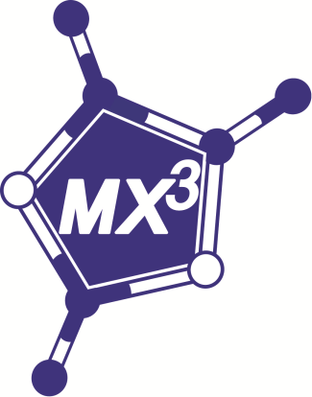
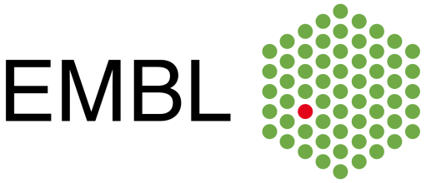
CRYSTALLIZATION PLATES DATA ACQUISITION IN MXCUBE
Jeremy SINOIR – EMBL Grenoble
Antonia BETEVA - ESRF

Slide 2


Crystallization plates data acquisition in mxcube
PLATE GRIPPER
Put in place of the goniometer head on the EMBL Micro Diffractometer(s)
Compatible with MD2-S and MD3 (and soon MD3-UP)
Allows data collection directly from crystallization plates at RT
Compatible with CrystalDirect, Mitegen inSitu-1 and Crystal Quick X
Designed by EMBL Grenoble, commercialized by MAATEL
Integrated at ESRF in 2016 (ID30B) : EMBL/ESRF Collaboration

Slide 3
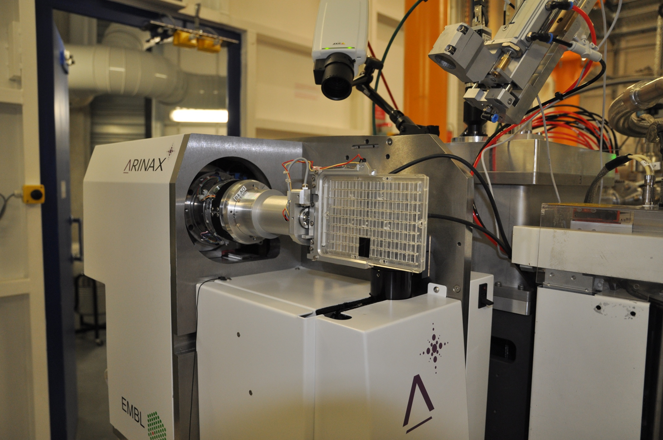

Crystallization plates data acquisition in mxcube
AlignY
Dedicated Motor : Plate Translation

Slide 4

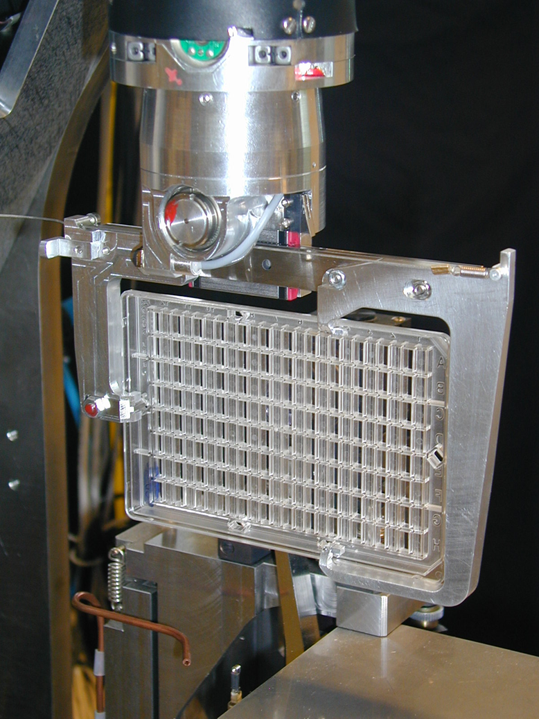
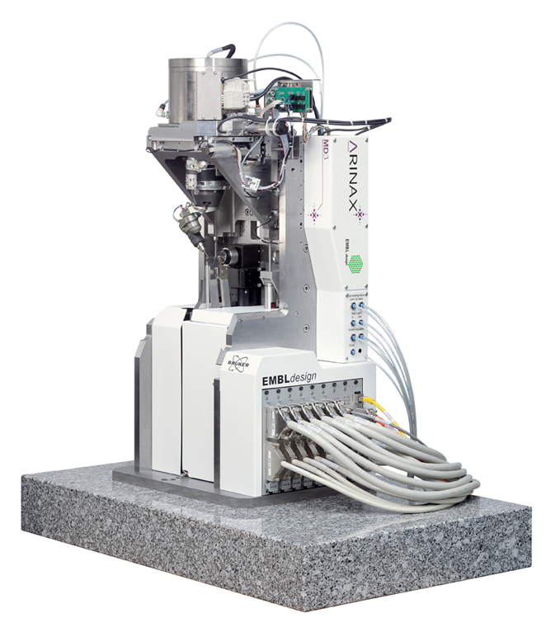
Crystallization plates data acquisition in mxcube
MD3 VERSION

Slide 5
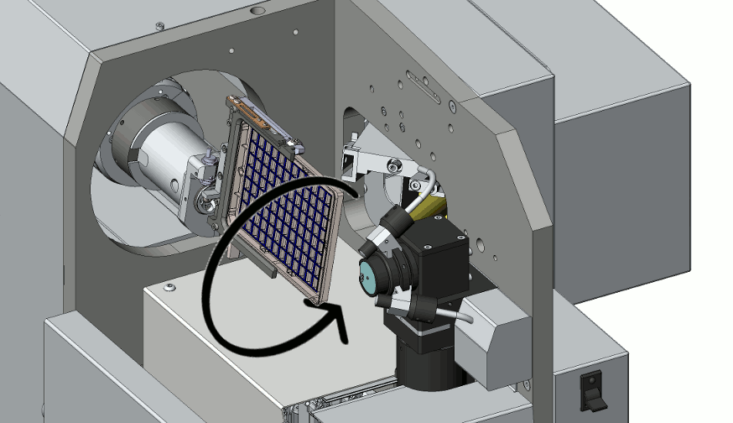
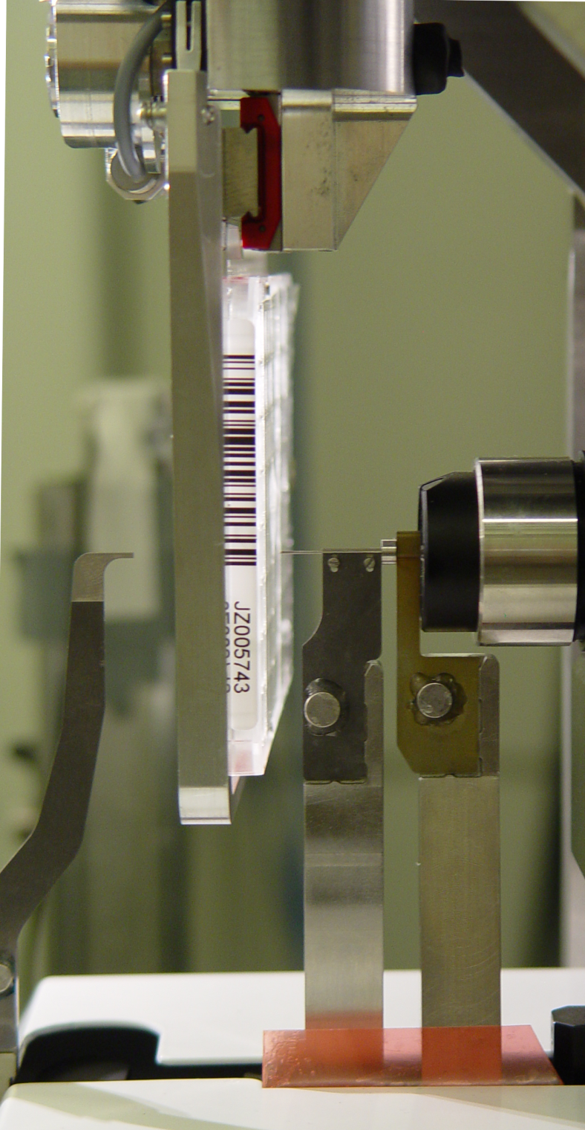
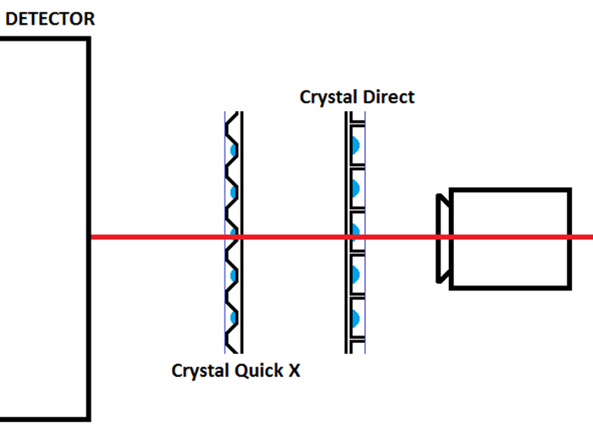
Crystallization plates data acquisition in mxcube
User-assisted homing and interlock definition
Highly constrained environment
Two shooting configurations

Slide 6
Crystallization plates data acquisition in mxcube
CENTRING METHODS
Goniometer/Minikappa Head
Manual – 3 click centring
Semi-automatic – centre with lucid2 and then confirm or refine with manual centring
Plate Gripper
Manual – 1 click centring, executed as many times as desired
Semi-automatic – click and focus and then confirm or refine with manual centring

Slide 7
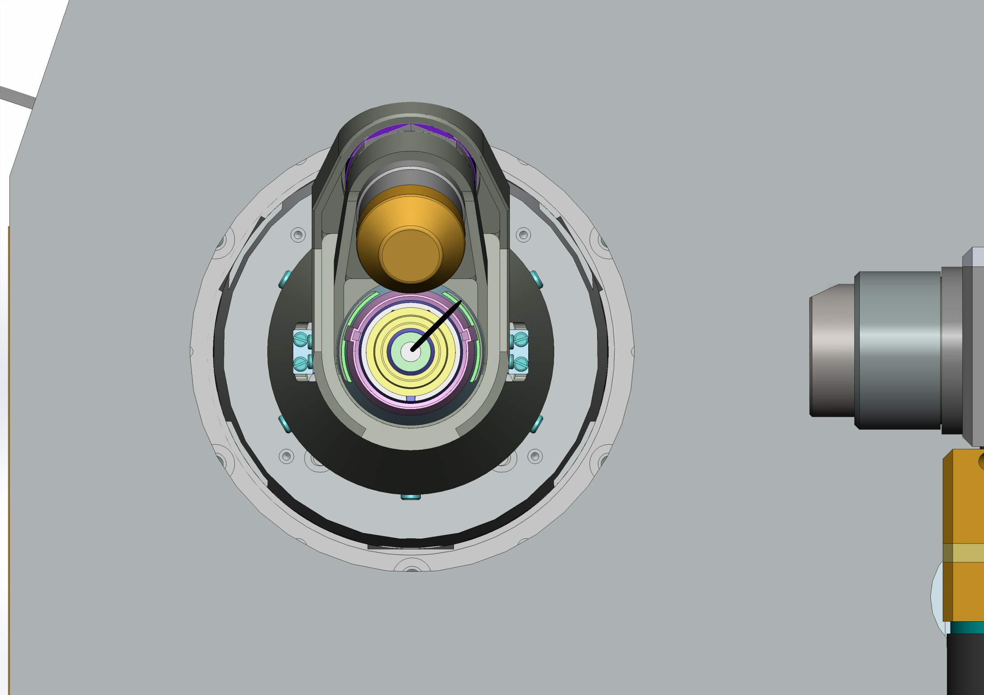
Crystallization plates data acquisition in mxcube

Slide 8
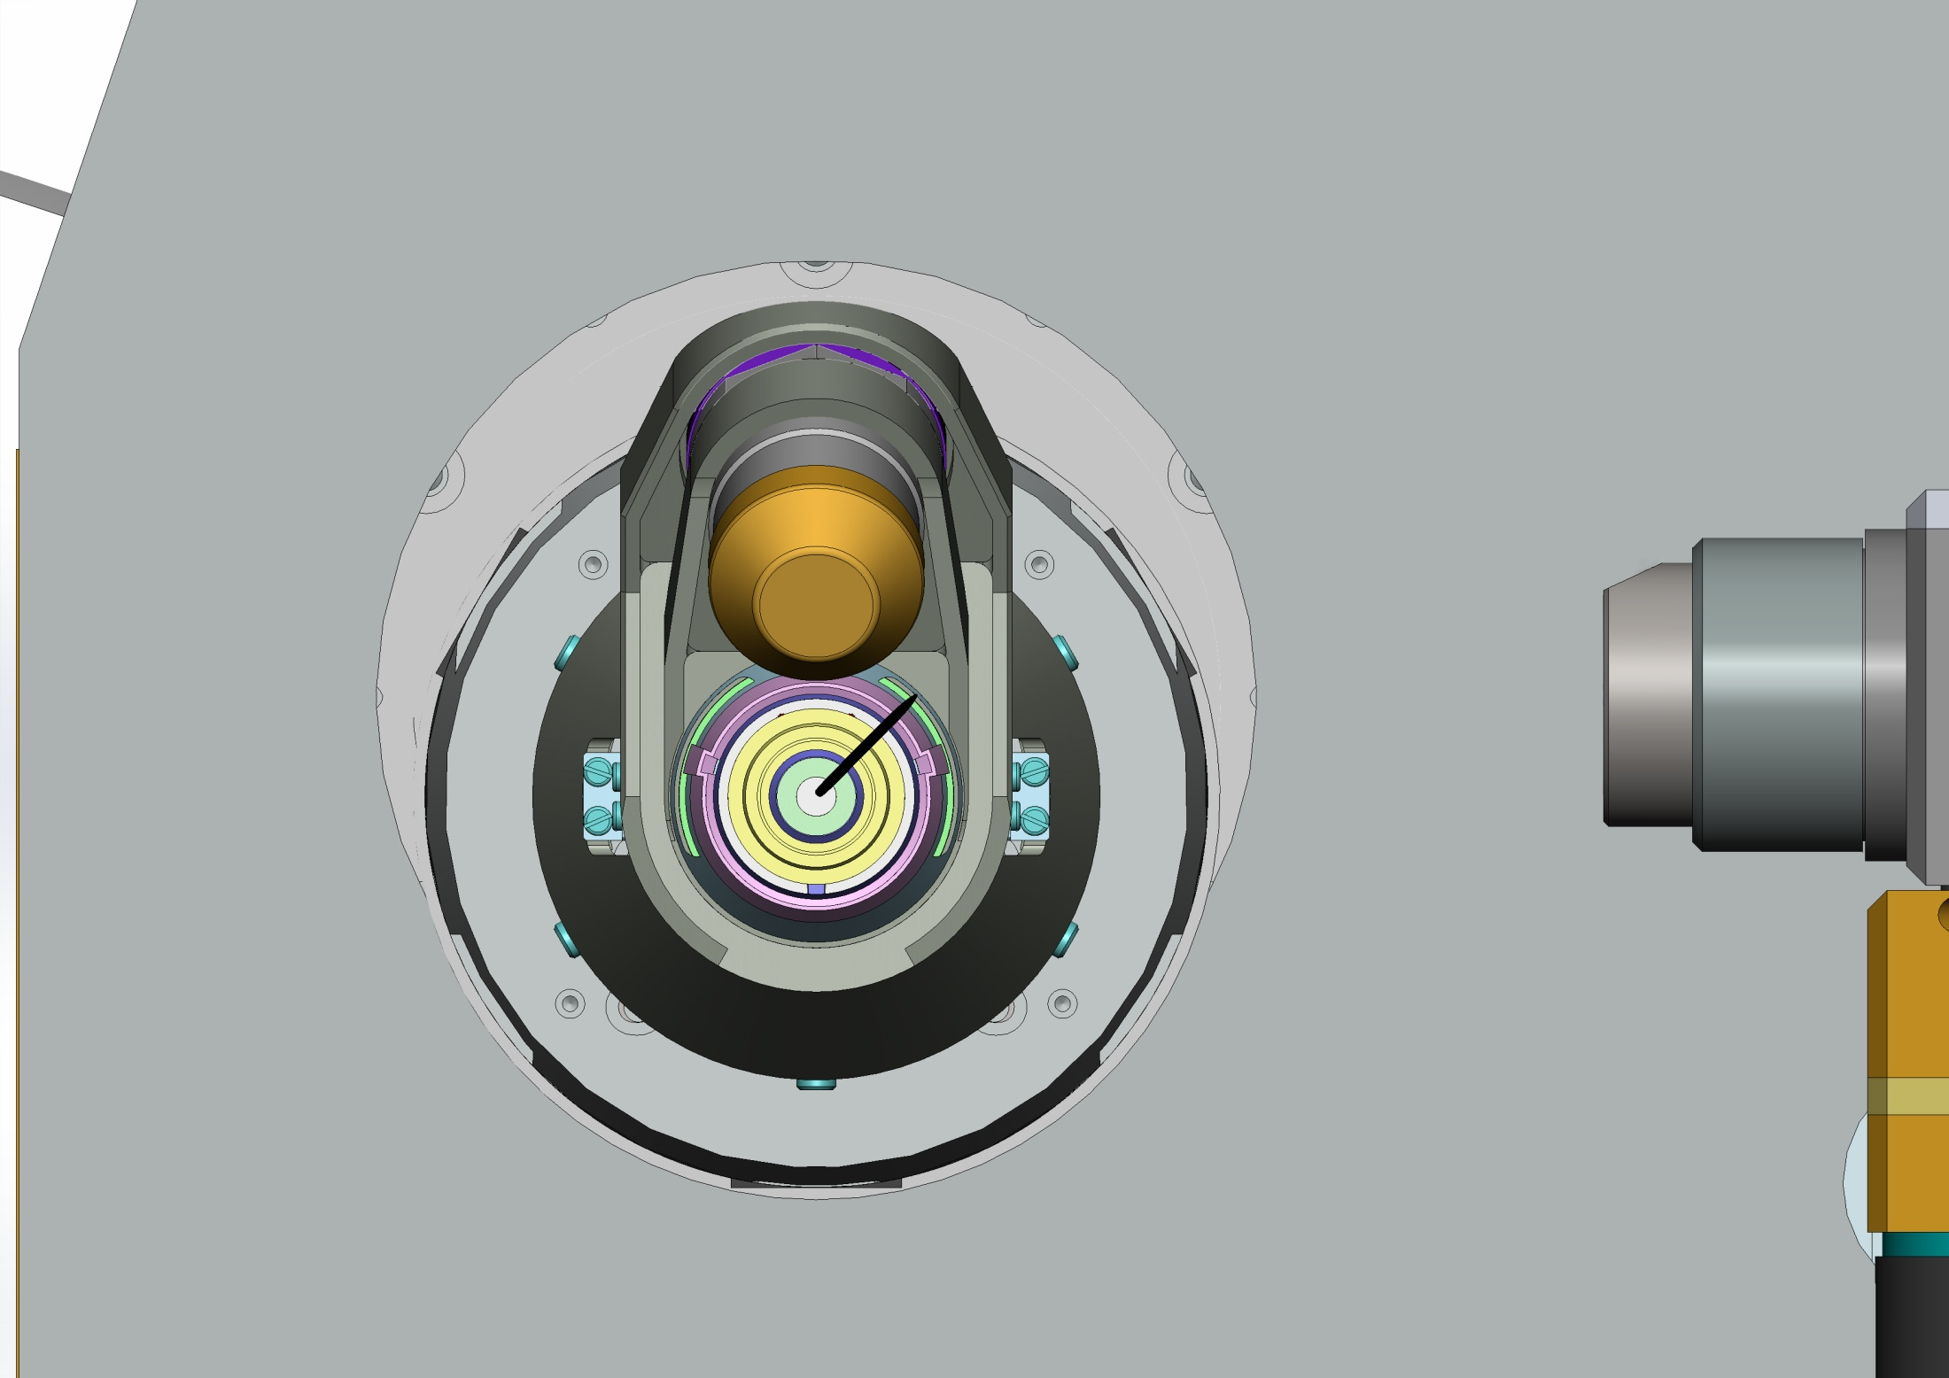
Crystallization plates data acquisition in mxcube

Slide 9
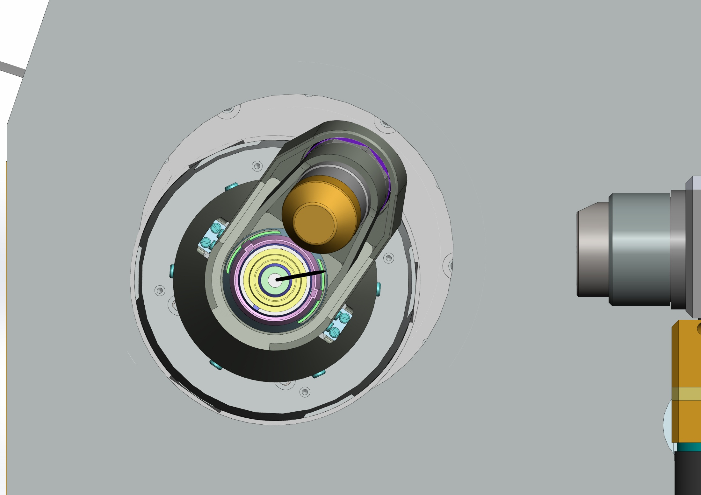
Crystallization plates data acquisition in mxcube

Slide 10
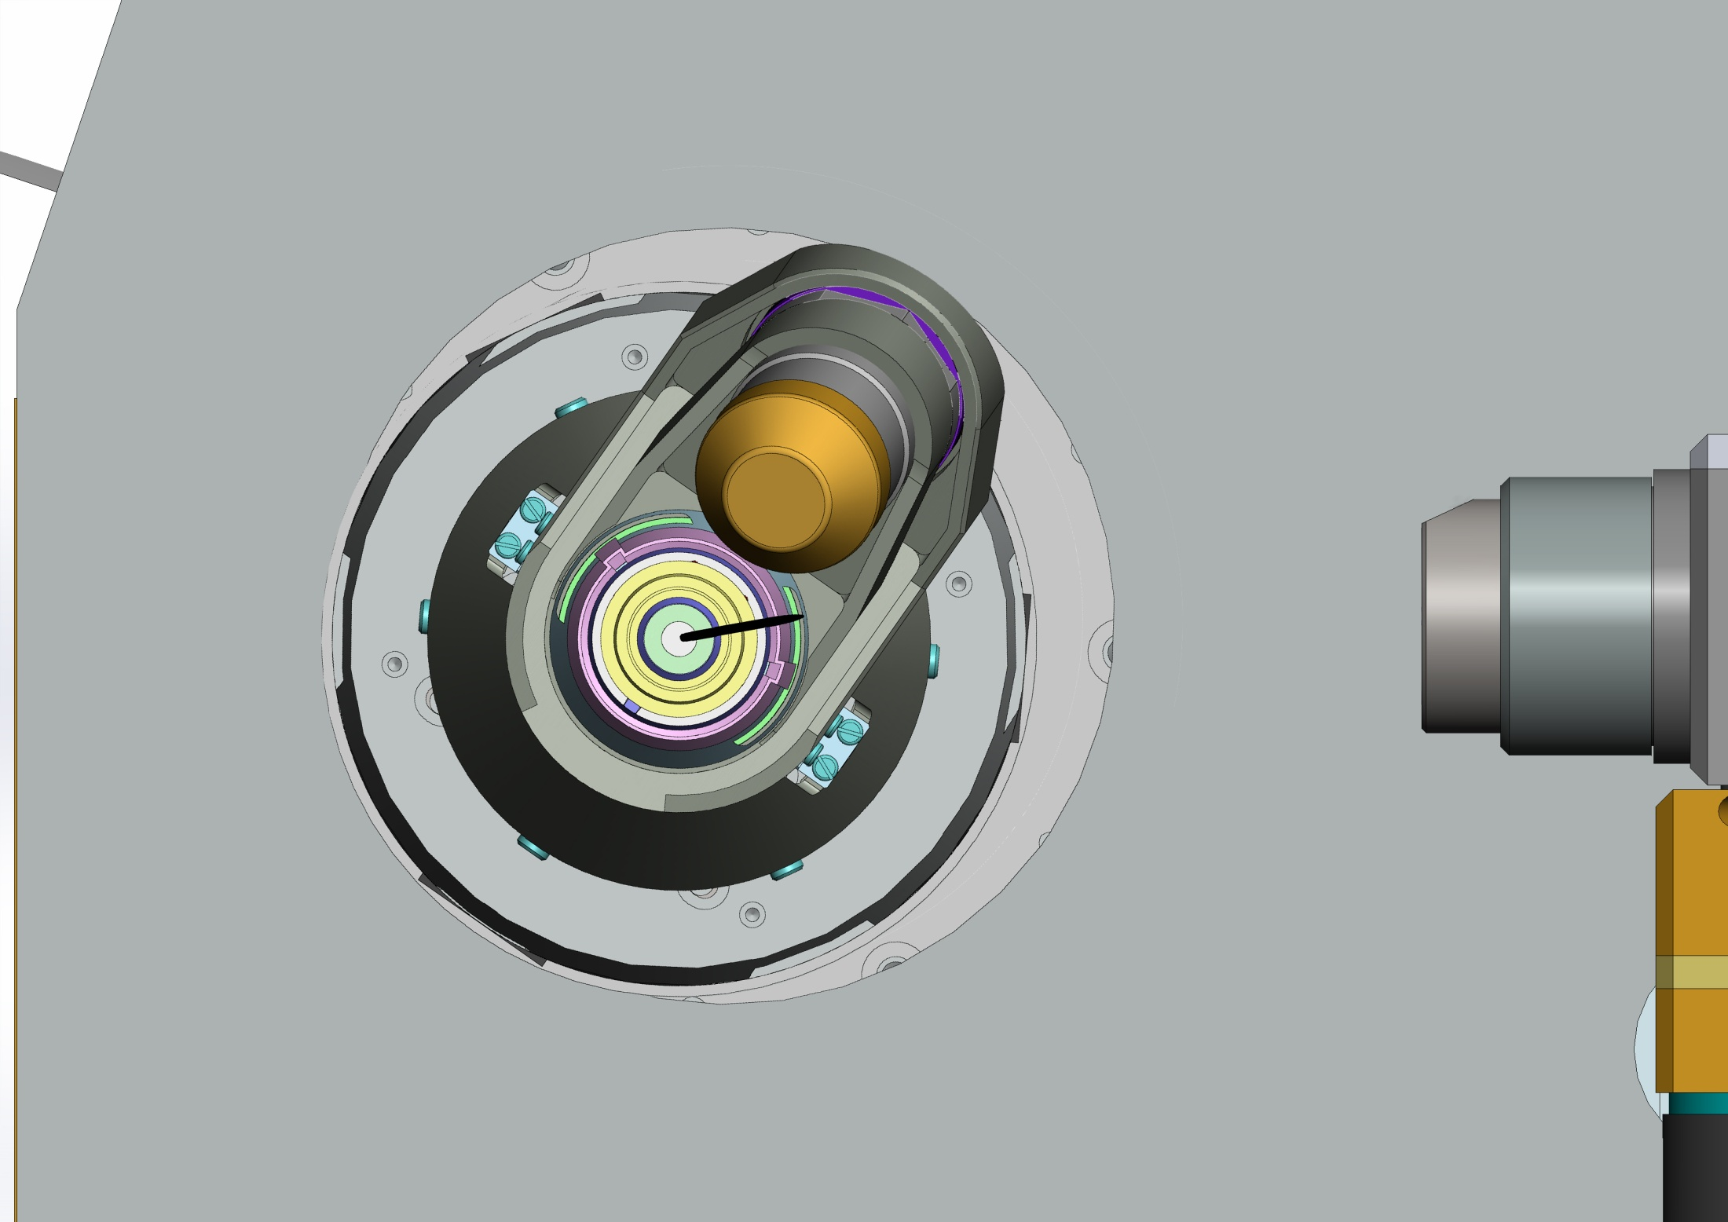
Crystallization plates data acquisition in mxcube

Slide 11
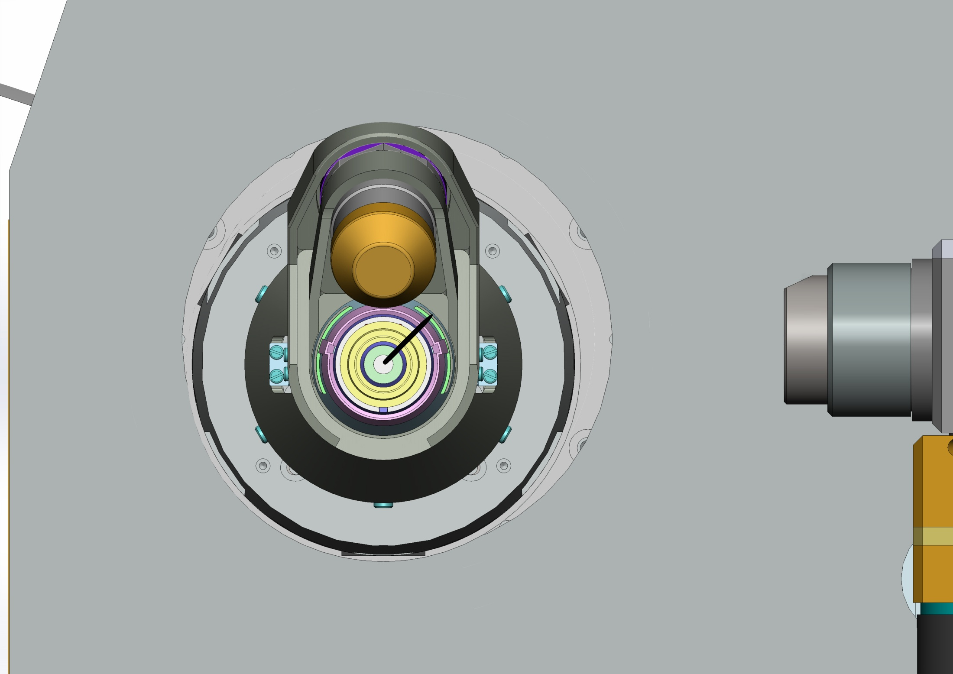
Crystallization plates data acquisition in mxcube

Slide 12
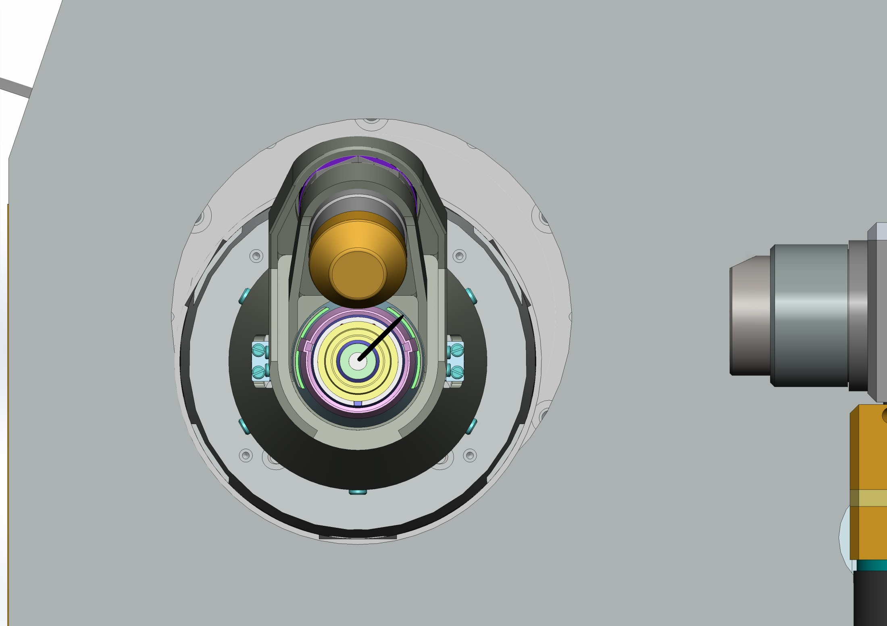
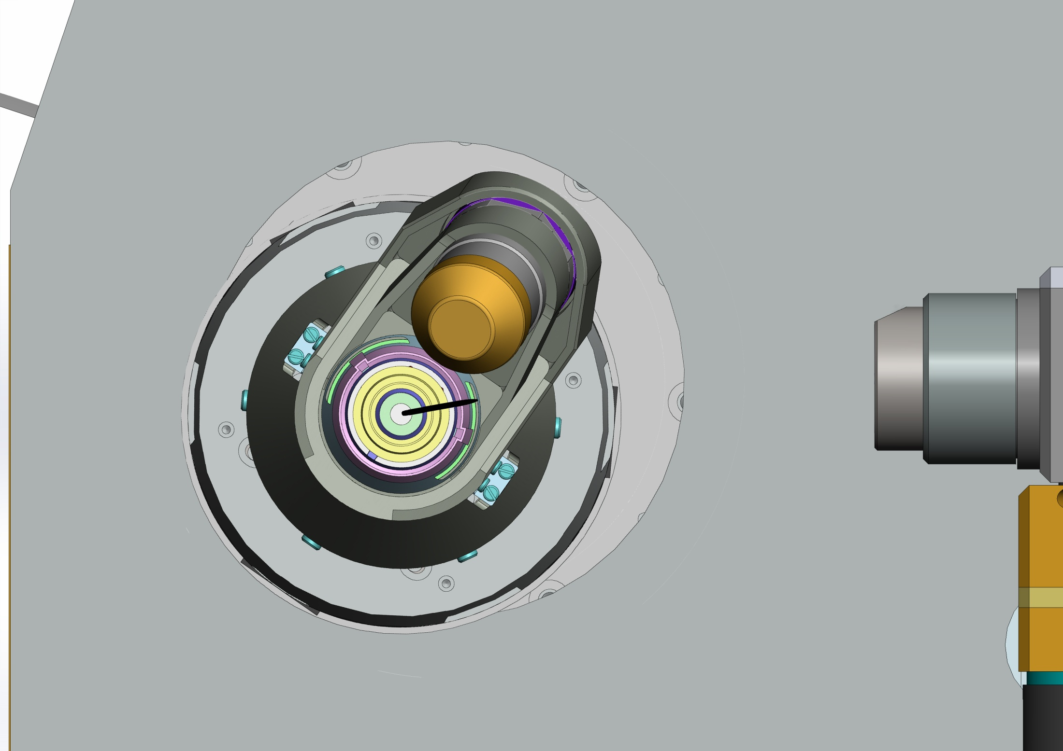
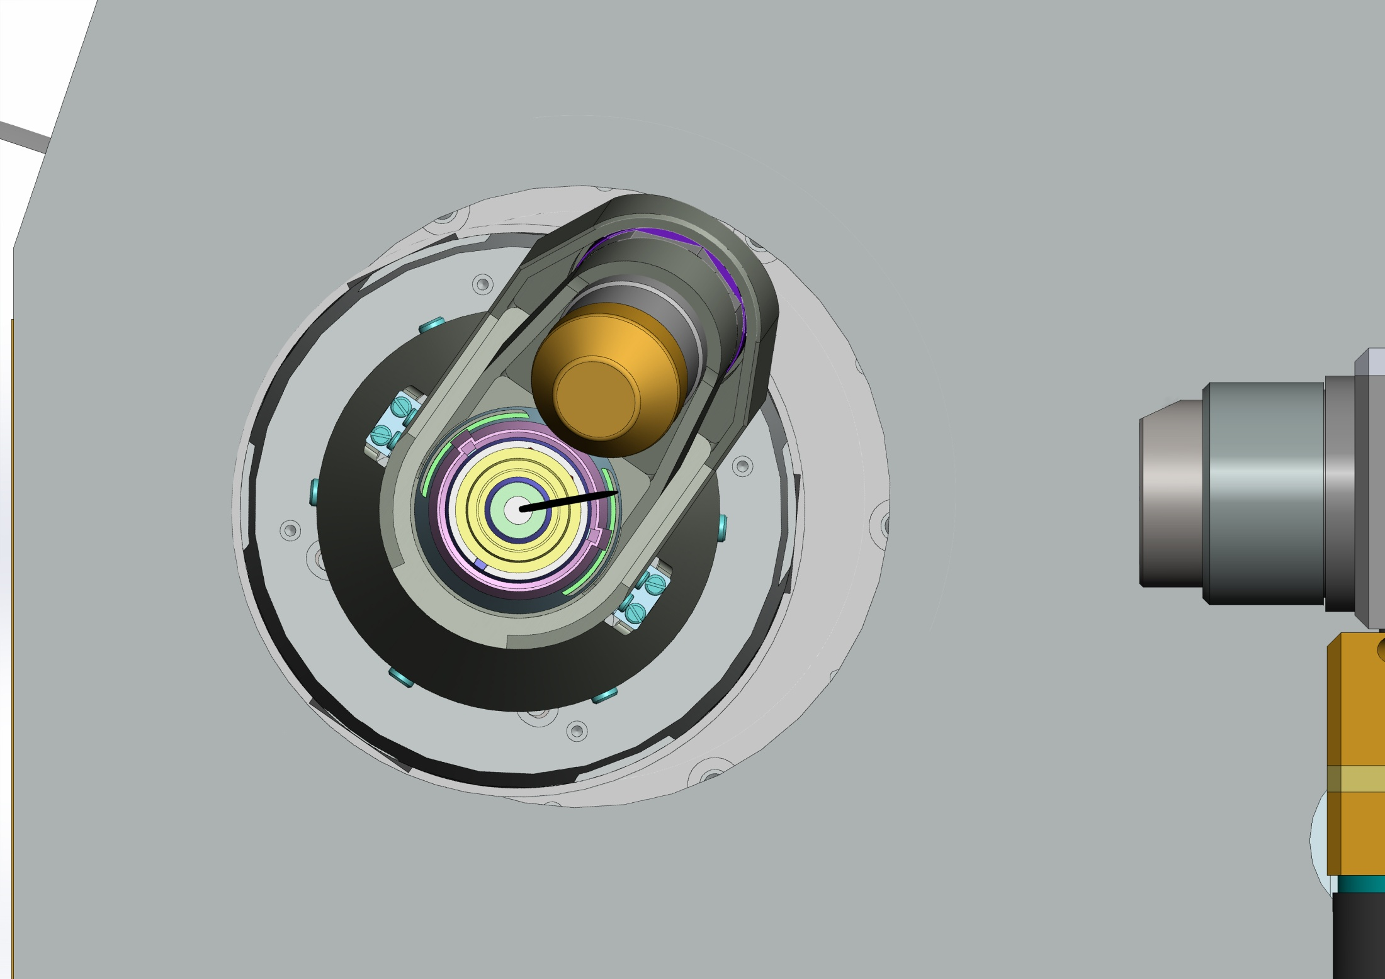
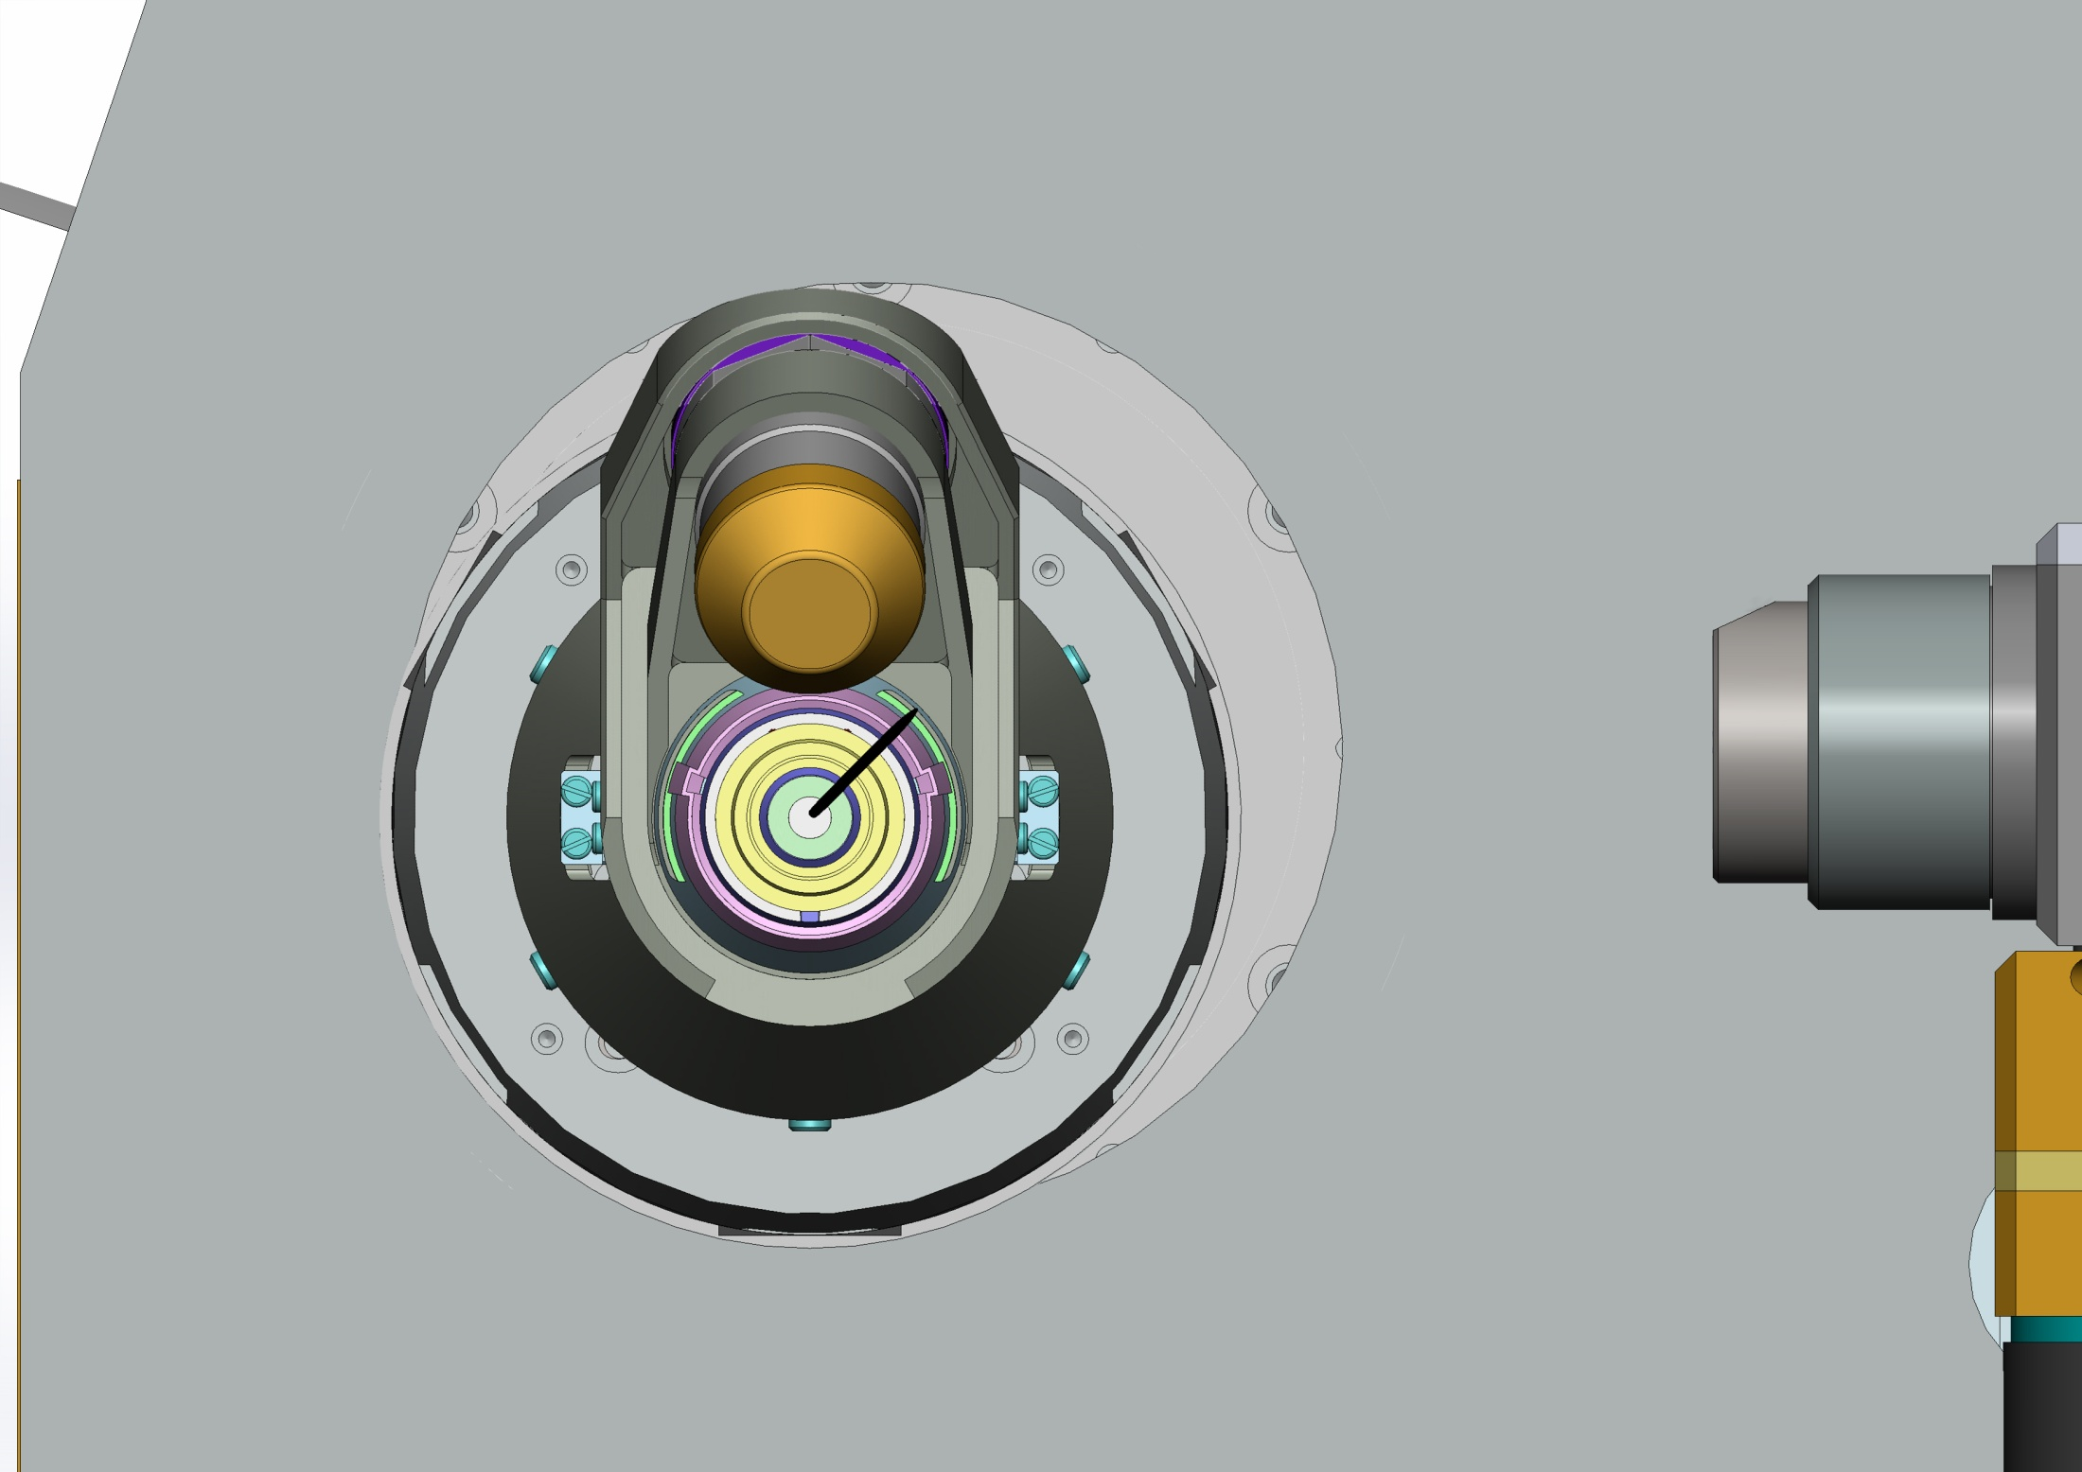
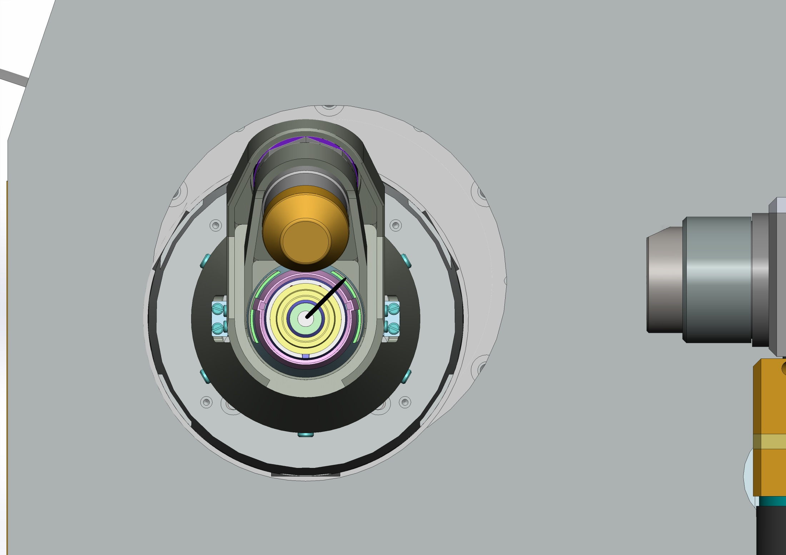
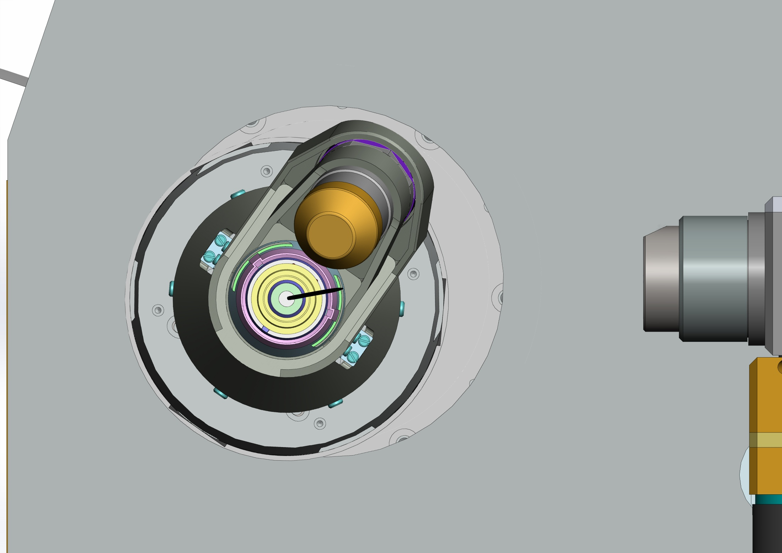
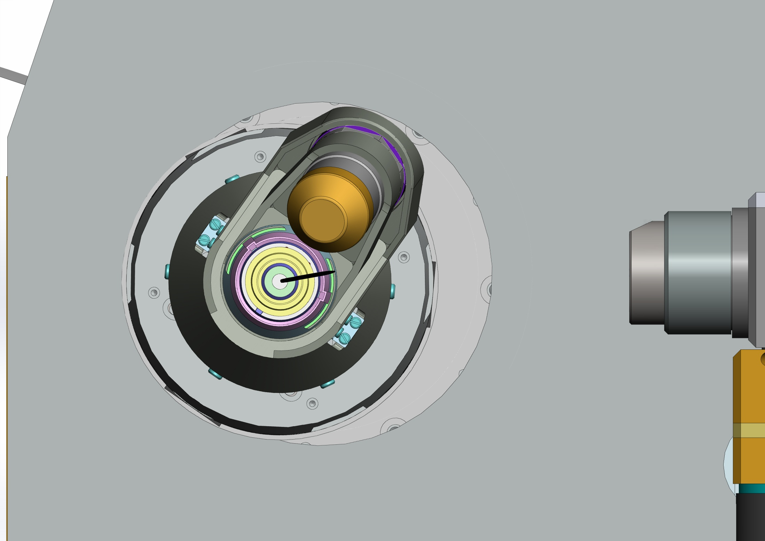
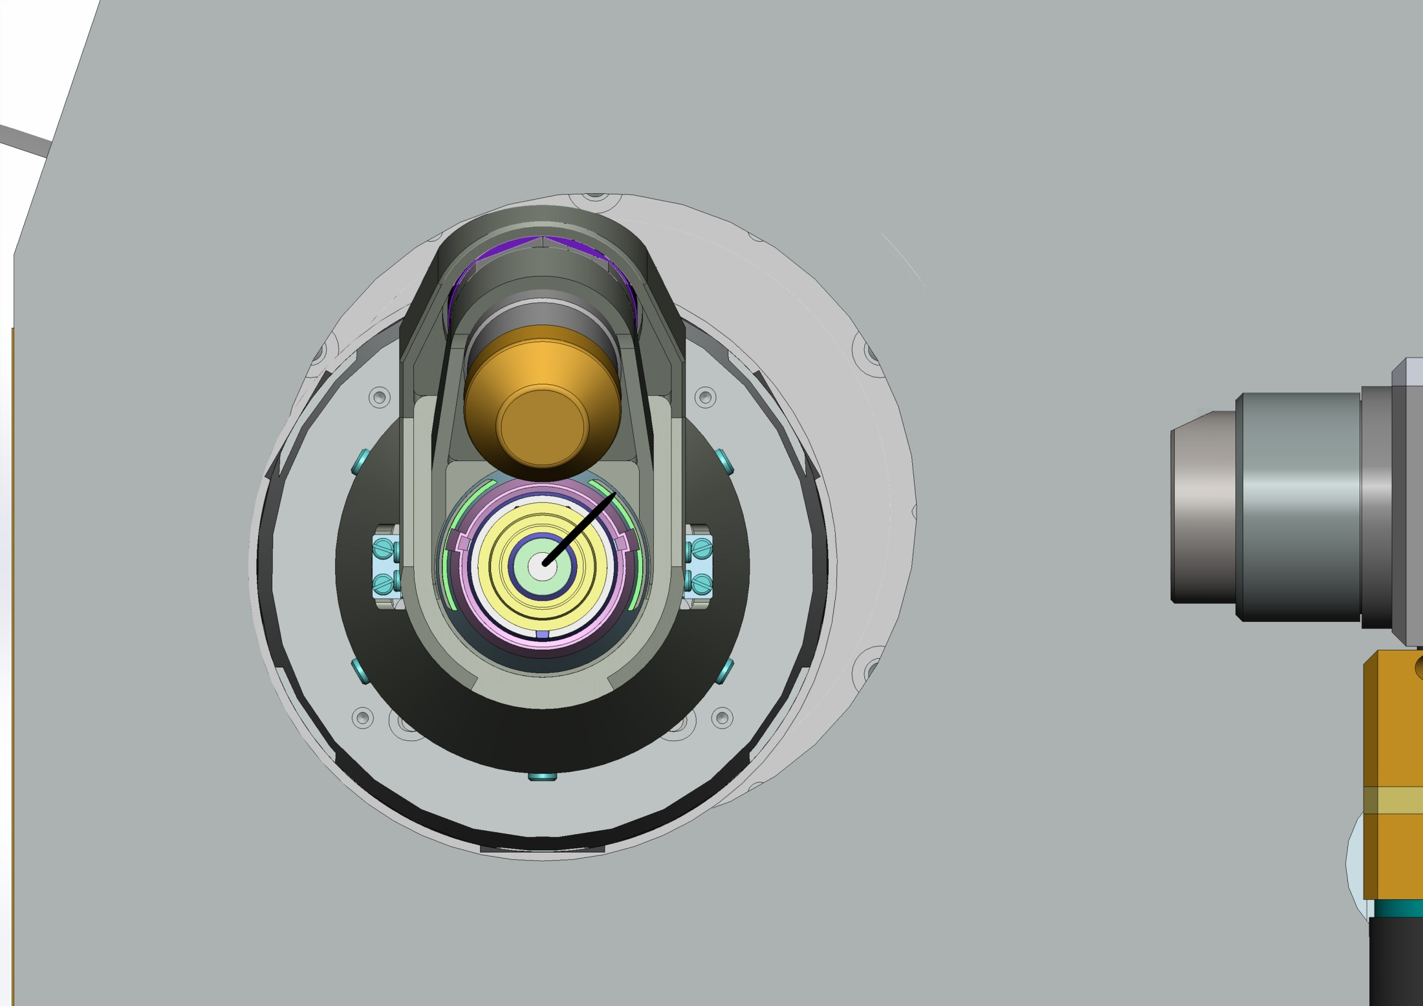
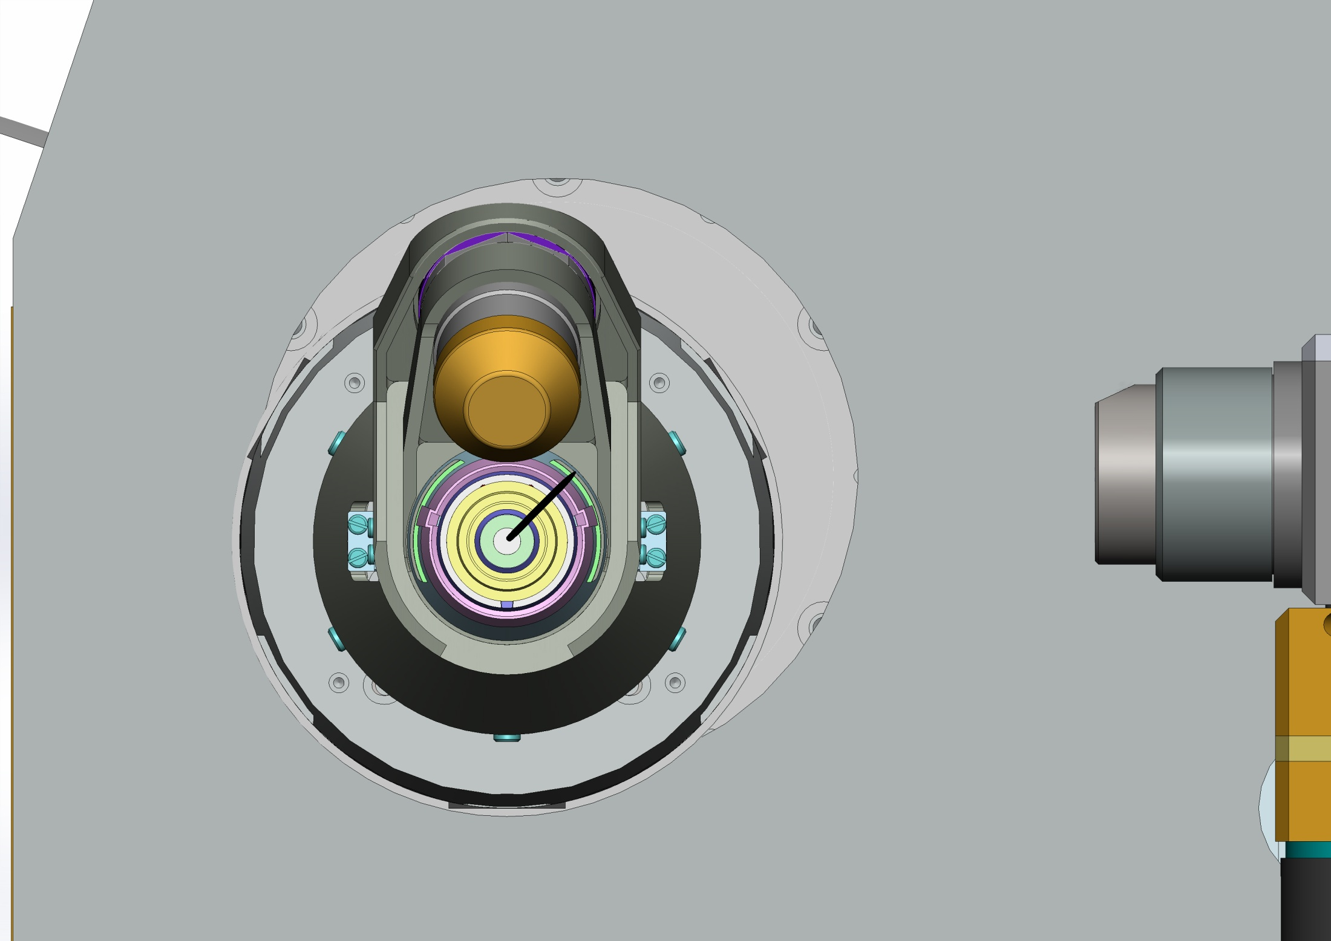
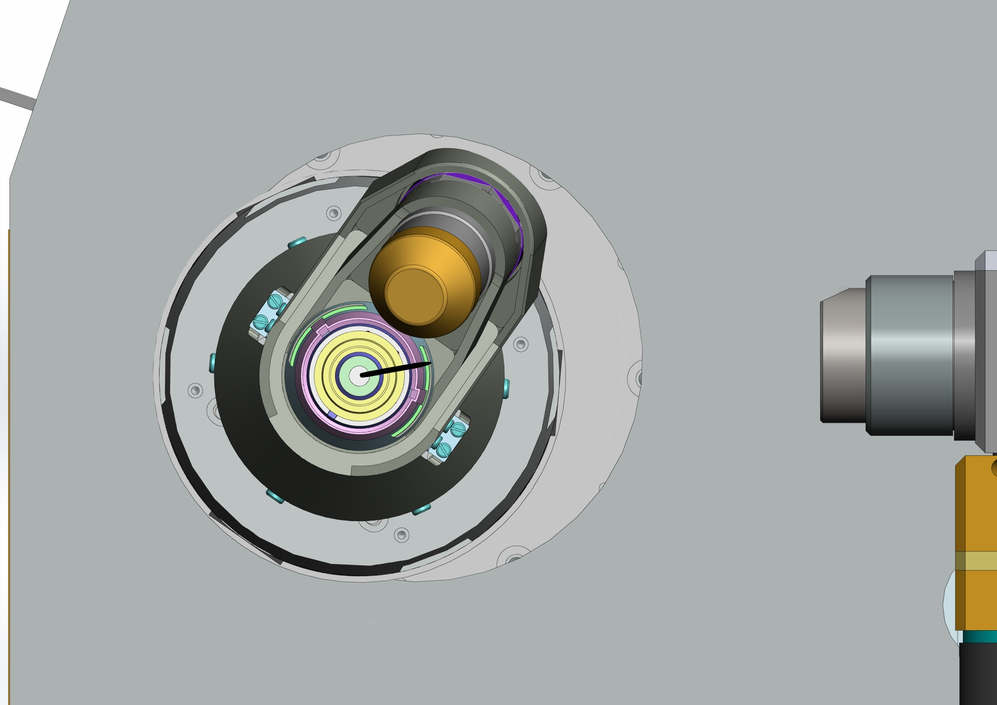


Crystallization plates data acquisition in mxcube

Slide 13
Crystallization plates data acquisition in mxcube

Slide 14
Crystallization plates data acquisition in mxcube

Slide 15
Crystallization plates data acquisition in mxcube

Slide 16
Crystallization plates data acquisition in mxcube

Slide 17
Crystallization plates data acquisition in mxcube

Slide 18
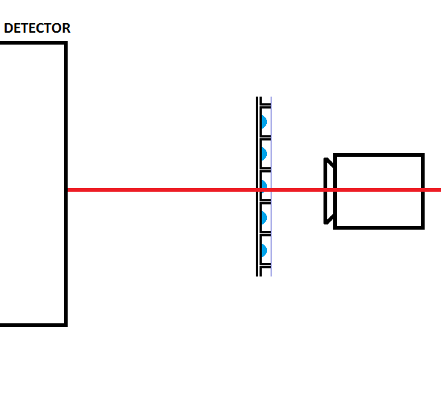
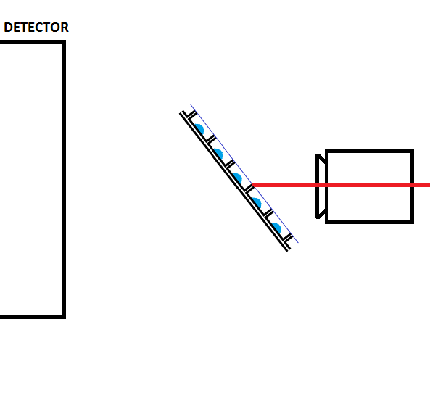
Crystallization plates data acquisition in mxcube
Omega rotation limitations

Slide 19
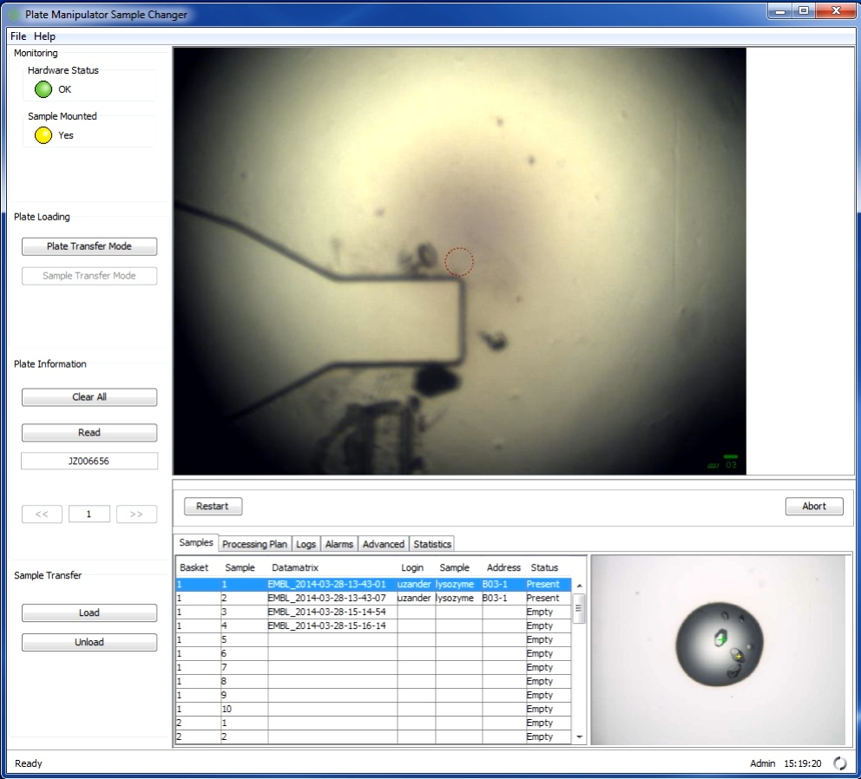
Crystallization plates data acquisition in mxcube
Image
Repositionning :

Slide 20
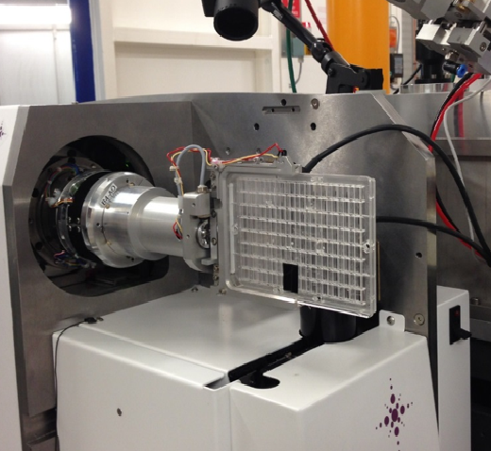
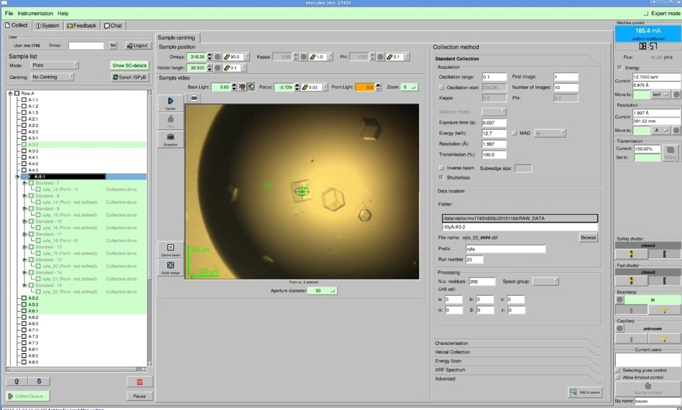
Crystallization plates data acquisition in mxcube

Slide 21
Crystallization plates data acquisition in mxcube
Adaptation of the EMBL Hamburg Implementation
Sample changer look and behave like
Specific hardware object – PlateManipulator.
Load is actually moving to a drop. No unload
Changes in TreeBrick and in queue (slightly different representation, no automatic centring, no specific detailed brick).
Goniometer head and not a sample changer
Handled by AbstractDiffractometer and Microdiff hardware objects.
Separate role in BeamlineSetup
Centring
1 click centring, as many times as desired – HutchMenuBrick.
Use different motors – MicrodiffFocusMotor, PlateTranslation

